Slide 1
Result Management System
Problem Statement, USE CASE, DFD

Slide 2
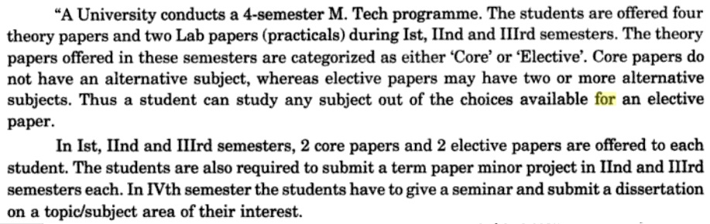
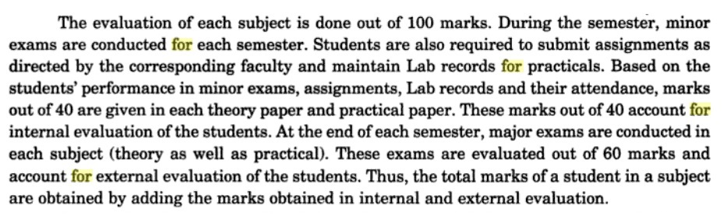
Problem Statement
Result Management System

Slide 3
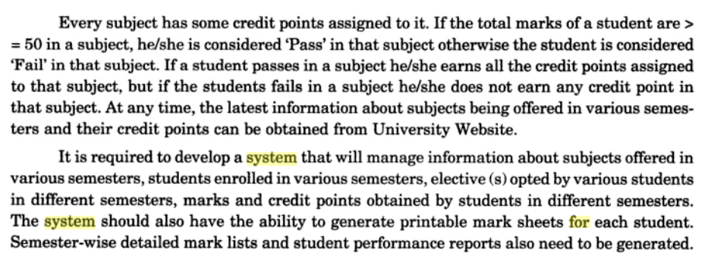
Problem Statement contd.
Result Management System

Slide 4
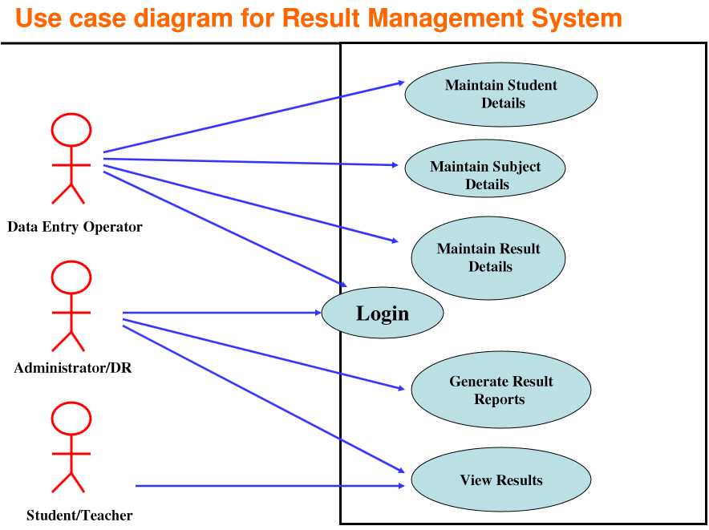

Slide 5
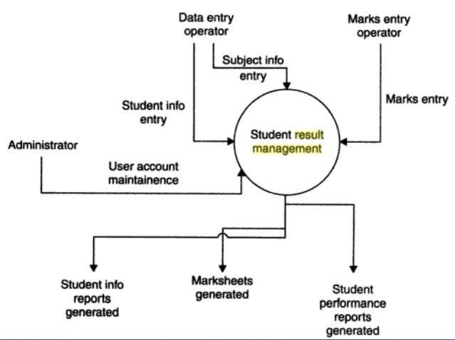
Data Flow Diagram
0-Level Diagram or Context Diagram

Slide 6
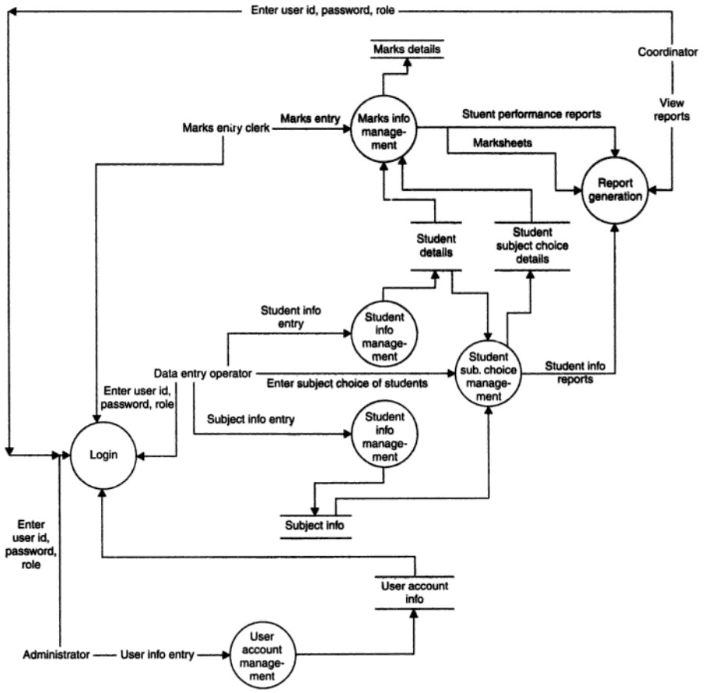
1-Level Diagram

Slide 7
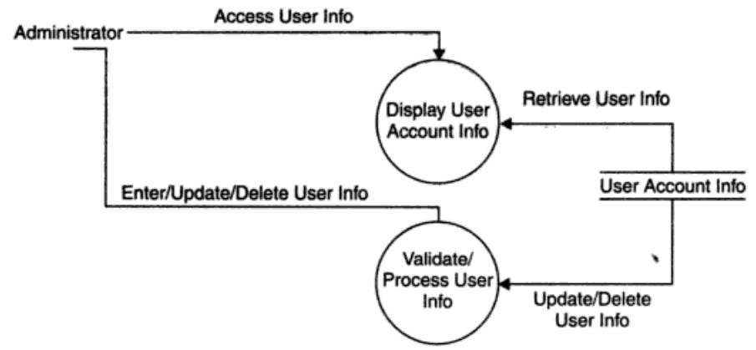
2-Level Diagram
User Account Maintenance Information Management

Slide 8
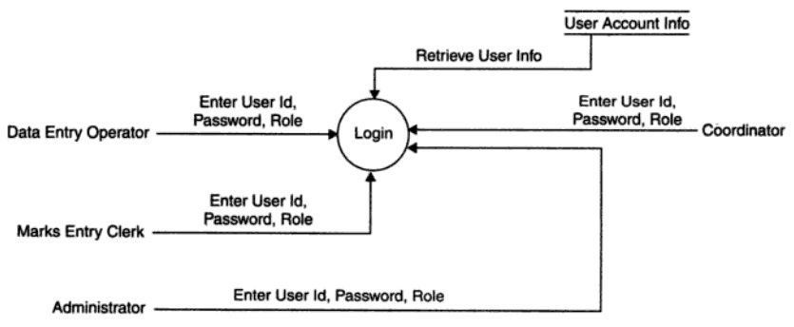
2-Level Diagram
Login Information Management

Slide 9
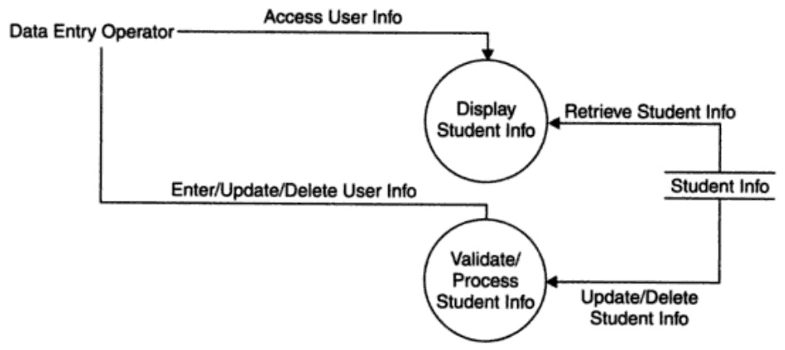
2-Level Diagram
Student Information Management

Slide 10
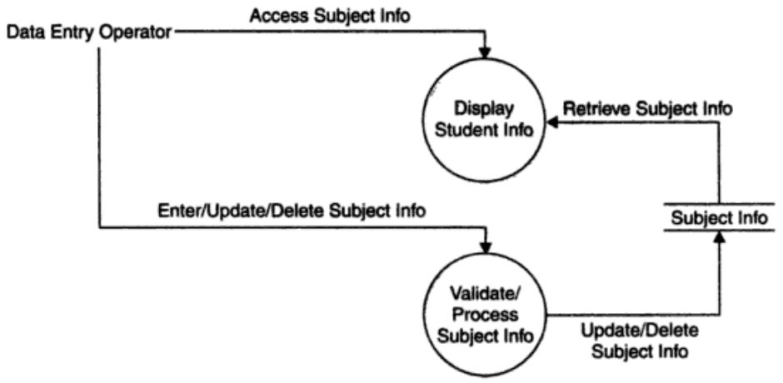
2-Level Diagram
Subject Information Management

Slide 11
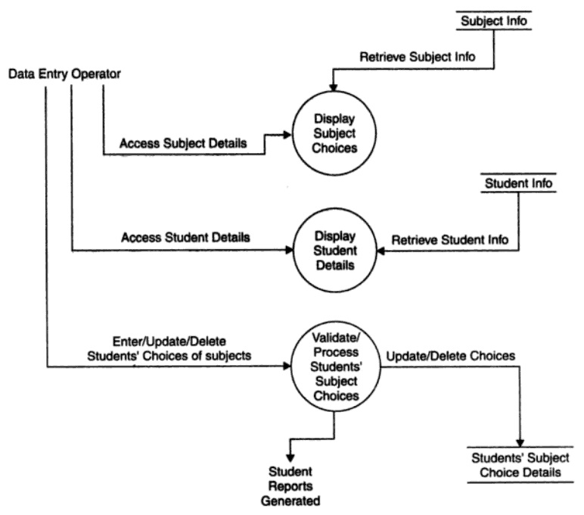
2-Level Diagram
Student-Subject Choice Information Management

Slide 12
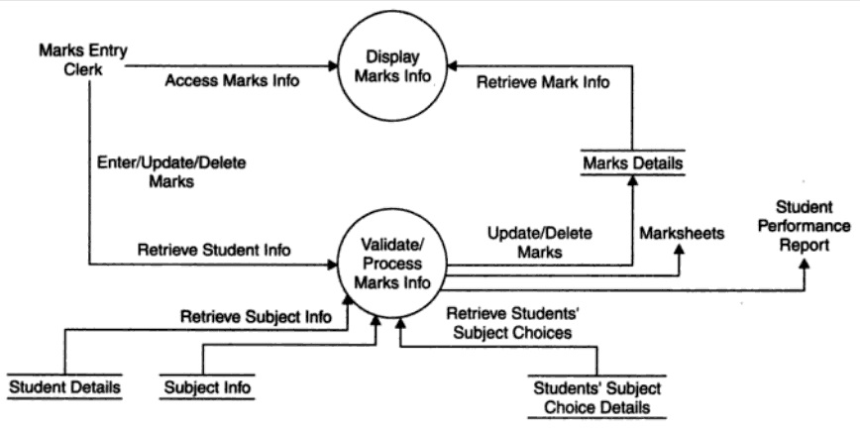
2-Level Diagram
Marks Information Management

Slide 13
Assignment
Prepare E-R Diagram for
Result Management System

